Slide 1
Jones, J. (2017, February 1). Scenery, machinery, people—Rethinking our view of humans. The Culture Blend.
http://www.thecultureblend.com/scenery-machinery-people-rethinking-our-view-of-humans/

Slide 2
Scenery, Machinery, People
SCENERY encompasses everything off in the distance worth looking at and talking about. Mountains. Clouds. Trees. Fascinating things. Confusing things. Fun to explore and great for conversation, but not a priority for the farmer.
MACHINERY is everything that helps the farmer accomplish goals and get work done. Tractors. Horses. Pitchforks. It exists solely to accommodate the farmer. Machine maintenance is hard work but worth it because the farmer’s life is better when the machines work well. When they don’t, they get scrapped.
PEOPLE are people. Family. Friends. Neighbors. Complex relationships that involve give and take. Emotions are invested, and benefits and challenges are mutual (although not necessarily balanced). People are also high maintenance but less likely to be scrapped because they hold intrinsic value.

Slide 3
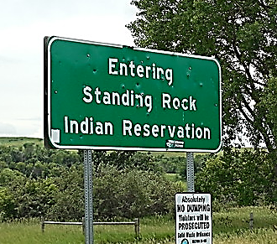
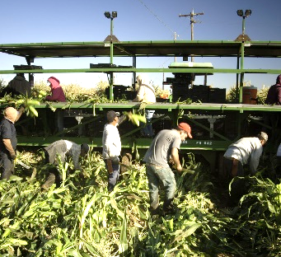
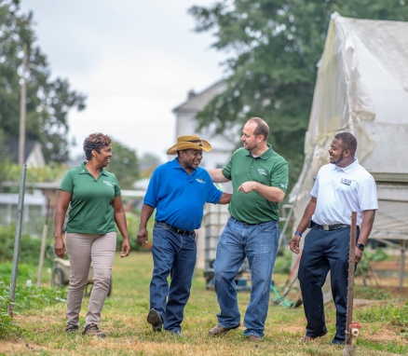
Scenery, Machinery, People
The Native Americans off in the distance with their strange clothes and confusing rituals were definitely worth talking about and absolutely fascinating to watch… but not so significant day to day to the non-native farmer.
They were scenery.
The hired help—the farm hands—the transient laborers were good to have around, especially if you got a strong one at a low wage. They were incredibly helpful…until they weren’t.
They were machinery.
The prime spot was reserved exclusively for those worth a relationship. Family, friends, neighbors and other farmers. Despite the fact that they were not the only humans in the picture, they had a category all their own.
They were the only people.
Jim Emerson https://www.flickr.com/photos/auvet/14674479311/in/photostream/, http://www.publicdomainfiles.com/show_file.php?id=13993279815379, https://www.farmers.gov/connect/blog/growing-farmersgov/farmers-farmers-usda-employee-puts-farmer-first-farmersgov

Slide 4
Scenery, Machinery, People
FOR WHOM ARE YOU…
?
FOR YOU, WHO ARE…
?
Acheson, K. (2017). Scenery, machinery, people. The HubICL. https://hubicl.org/toolbox/tools/109/objectives

